Slide 1
Introduction to Linux
Linux 1 Day 1

Slide 2
Class Objectives
By the end of class, you will be able to:
Name three of the most important Linux distributions.
Navigate the Linux file structure using the command line.
Manage processes with the top, ps, and kill commands.
Install packages using apt.
Edit configuration files using nano.

Slide 3

So, Why Linux?
Notes:
shutterstock_419292739

Slide 4

Why Linux
Over 70% of websites run some version of Unix.
w3techs.com
Notes:
shutterstock_596101424

Slide 5



Why Linux
Unix refers to Linux and “Linux-like” operating systems.
Notes:
shutterstock_419292739

Slide 6

Why Linux
The ubiquity of Linux machines on modern networks makes it a common target for attackers.
Notes:
shutterstock_534253945

Slide 7
Familiarity with the operating system is crucial for cybersecurity professionals.

Slide 8
Linux in a Professional Context
Knowledge is essential for the following technical roles, among others:
Help Desk / IT Support
System Administration
Penetration Testing
Network Forensics

Slide 9


Activity Scenario
Throughout today’s exercises, you will:
Investigate a malfunctioning Linux server reported to be running more slowly than usual. | Identify suspicious activity on the system and then contain it. | Methodology will include:
 |  | Auditing files
 |  | Auditing processes
 |  | Installing security packages
 |  | Configuring security services

Slide 10
Linux History and Distributions

Slide 11

An operating system (OS) is a platform that allows users to install and run applications on a machine.

Slide 12

An Introduction to Linux
Windows, Mac OS X, and Linux are all examples of operating systems.
Notes:
shutterstock_419292739

Slide 13

By W3Cook's analysis of Alexa's data, 96.3% of the top one million web servers are running Linux. The remainder is split between Windows, 1.9%, and FreeBSD, 1.8%.
—Steven J. Vaughan-Nichols
zdnet.com
Notes:
Source: https://www.zdnet.com/article/can-the-internet-exist-without-linux/

Slide 14

Most enterprise networks feature at least one Linux machine.
Notes:
shutterstock_732692350

Slide 15
Unlike Windows and OS X, Linux is free, open source software (FOSS).

Slide 16

Anyone can modify the source code.
Notes:
shutterstock_491237230

Slide 17

In the early days of computers, researchers and students needed an inexpensive and accessible operating system to modify and learn from.
Notes:
shutterstock_413733049

Slide 18
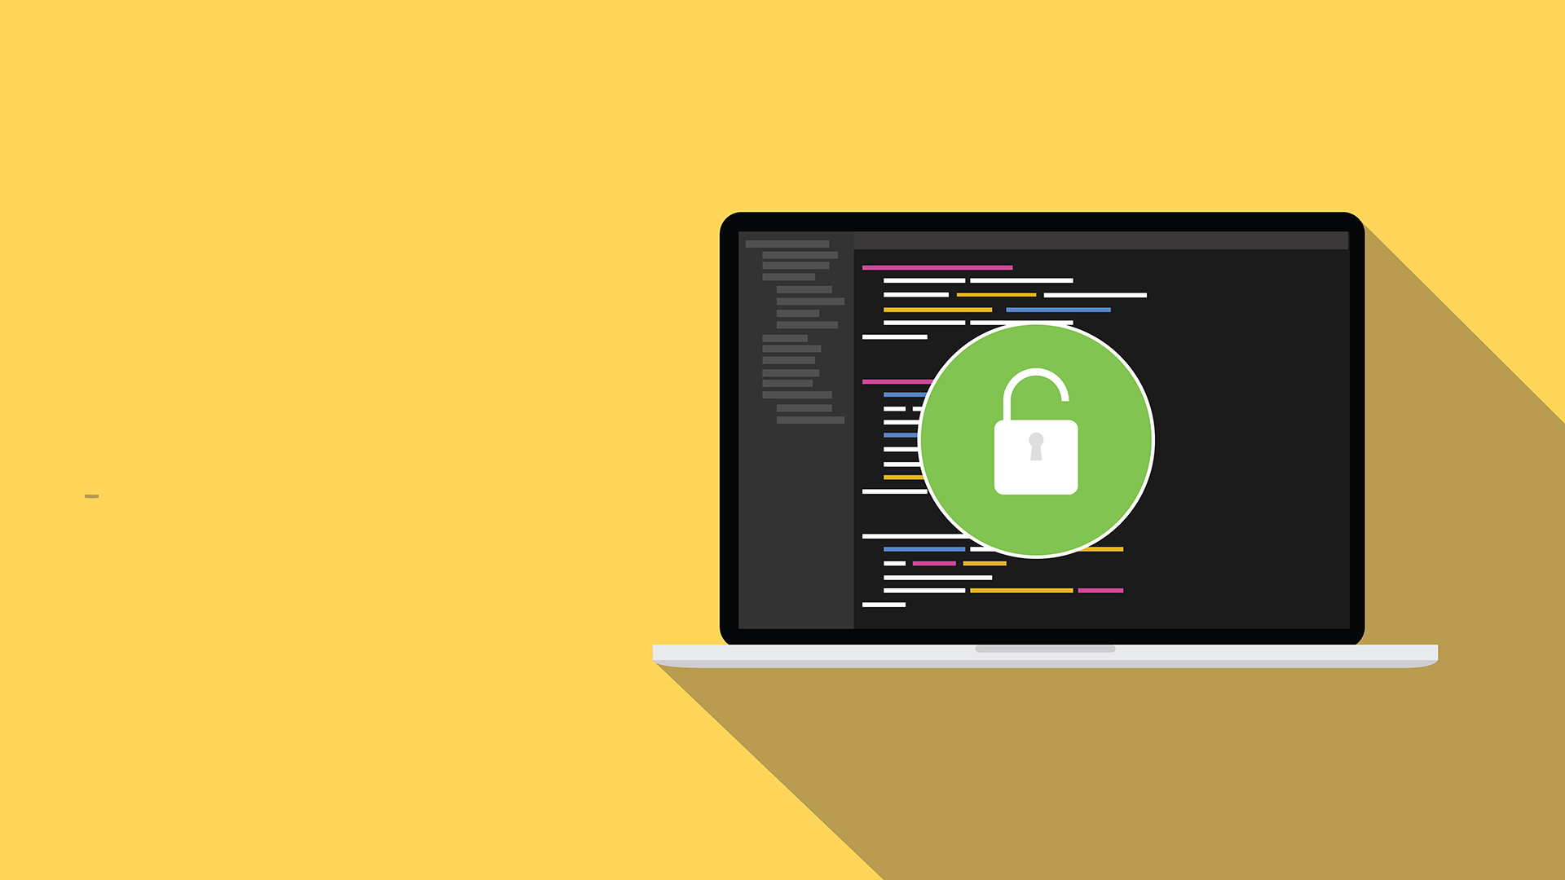
Most tools in the hacker / security community are still published as open-source.
Free software and information is prevalent in the industry. Almost all the tools we’ll use in class are open source.
Notes:
shutterstock_488480038

Slide 19
Distributions

Slide 20
Distributions are special-purpose variants of the operating system

Slide 21


Linux Distributions
In this course, we’ll use two distributions: Ubuntu and Kali Linux.
Ubuntu
Kali Linux
Ubuntu is geared towards general-purpose users.
Kali is designed specifically for security professionals.

Slide 22

Linux Distributions
Ubuntu and Kali Linux are both specialized versions of a distribution called Debian.

Slide 23

Linux Servers
In order to conserve as many resources as possible, most production Linux servers don’t offer a graphical interface.
Therefore knowledge of the command-line is essential for understanding Linux.
Notes:
shutterstock_185734466

Slide 24

These command-line only machines are called
headless servers.
>_
Notes:
shutterstock_1202854222

Slide 25
Activity: Distribution Research
You are a system administrator at X Corp, which has recently experienced a number of breaches involving servers running outdated Linux distributions.
In response, the IT Department has decided to upgrade the affected servers with new versions of Linux.
You must conduct research to determine which distribution is most appropriate for each machine.
10 Minutes

Slide 27
Distribution Research Review
Identify which distribution(s) is most appropriate for each situation.
Central Data Server
Public Web Server
IT Audit Workstation
User Workstation

Slide 28
Distribution Research Review
Identify which distribution(s) is most appropriate for each situation.
Central Data Server | Stores sensitive human resources data, so should use a secure distribution. Fedora and CentOS use SELinux by default, making them good choices.
Public Web Server
IT Audit Workstation
User Workstation

Slide 29
Distribution Research Review
Identify which distribution(s) is most appropriate for each situation.
Central Data Server | Stores sensitive human resources data, so should use a secure distribution. Fedora and CentOS use SELinux by default, making them good choices.
Public Web Server
IT Audit Workstation
User Workstation

Slide 30
Distribution Research Review
Identify which distribution(s) is most appropriate for each situation.
Central Data Server | Stores sensitive human resources data, so should use a secure distribution. Fedora and CentOS use SELinux by default, making them good choices.
Public Web Server | Needs to run quickly and handle large amounts of traffic. Many distributions could work, but Ubuntu and Fedora are among the best choices because they are well-supported.
IT Audit Workstation
User Workstation

Slide 31
Distribution Research Review
Identify which distribution(s) is most appropriate for each situation.
Central Data Server | Stores sensitive human resources data, so should use a secure distribution. Fedora and CentOS use SELinux by default, making them good choices.
Public Web Server | Needs to run quickly and handle large amounts of traffic. Many distributions could work, but Ubuntu and Fedora are among the best choices because they are well-supported.
IT Audit Workstation
User Workstation

Slide 32
Distribution Research Review
Identify which distribution(s) is most appropriate for each situation.
Central Data Server | Stores sensitive human resources data, so should use a secure distribution. Fedora and CentOS use SELinux by default, making them good choices.
Public Web Server | Needs to run quickly and handle large amounts of traffic. Many distributions could work, but Ubuntu and Fedora are among the best choices because they are well-supported.
IT Audit Workstation | Should use Kali Linux, because it specifically designed for performing security assessments.
User Workstation

Slide 33
Distribution Research Review
Identify which distribution(s) is most appropriate for each situation.
Central Data Server | Stores sensitive human resources data, so should use a secure distribution. Fedora and CentOS use SELinux by default, making them good choices.
Public Web Server | Needs to run quickly and handle large amounts of traffic. Many distributions could work, but Ubuntu and Fedora are among the best choices because they are well-supported.
IT Audit Workstation | Should use Kali Linux, because it specifically designed for performing security assessments.
User Workstation

Slide 34
Distribution Research Review
Identify which distribution(s) is most appropriate for each situation.
Central Data Server | Stores sensitive human resources data, so should use a secure distribution. Fedora and CentOS use SELinux by default, making them good choices.
Public Web Server | Needs to run quickly and handle large amounts of traffic. Many distributions could work, but Ubuntu and Fedora are among the best choices because they are well-supported.
IT Audit Workstation | Should use Kali Linux, because it specifically designed for performing security assessments.
User Workstation | Should use Ubuntu, which comes with a GUI and basic productivity software, such as an email client, web browser, and text editor.

Slide 35

Which distribution is most flexible and best suited for day-to-day and administrative tasks?

Slide 36
Answer

Slide 37
Which distribution is built specifically for penetration testers?

Slide 38
Answer

Slide 39
Which distribution would you use to set up a web or data server?

Slide 40
Answer
Any will work, but Ubuntu Server and Fedora Server both have easy-to-configure web services.
You could use Debian or CentOS for more manual tasks.

Slide 41
What is the most widely-used Linux desktop environment?

Slide 42
Answer

Slide 43
What is a headless server?

Slide 44
A command-line only server, without a desktop environment.
Answer
>_
Notes:
shutterstock_1202854222

Slide 45
Does Ubuntu have a headless server version? Does Fedora? CentOS?

Slide 46
Yes, all three distributions provide a headless server version.
Answer
>_
Notes:
shutterstock_1202854222

Slide 47
Which distribution is Ubuntu based on? What about Kali?

Slide 48
Answer
They are both based on Debian.

Slide 49
Which distribution is CentOS based on? What about Fedora?

Slide 50

Answer
Both distributions are based on RedHat.

Slide 51
What is SELinux?

Slide 52





What is SELinux?
SELinux is a built-in file permission security enhancement developed by the NSA. CentOS and Fedora have it implemented by default.
Subject
(eg: a process)
Action Request
(eg: read)
SELinux Security Server
Permission Granted?
Object
(eg: a file)
Yes
No
SELinux
Policy Database
AVC Denied Message

Slide 53
You are deciding between versions of Ubuntu Servers. If you want a version that will remain stable over time, which version do you choose?

Slide 54
Ubuntu Server Versions
You would want to choose the “Long Term Support” (LTS) version. The latest version will have continual updates and changes. The LTS version will remain stable and only change approximately once a year.

Slide 55
What are some security implications of using free and open source software or forks of popular Linux distributions?

Slide 56

As demonstrated in the Mint OS article, open source means that anyone can contribute. Therefore, a hacker with programming skills will be able to attack somewhat easily. You must be vigilant of where you download your software.
Notes:
shutterstock_491237230

Slide 57
Linux File System Structure

Slide 58
File Systems
All operating systems maintain certain conventions for storing files.
/ (root) | The root directory that contains every other directory.
/home | Contains users’ private file. Users should not be able to save files elsewhere.
/etc | Contains configuration files, defining how a machine runs and who can use it.
/bin, /sbin | Contain applications such as web browsers and commands like ls.
/var | Contains files that change over time.
/tmp | Contains files that are only needed for a short period of time.

Slide 59


Demo Scenario
Once we master the Linux file system structure, we can better identify files that are in places they do not belong.
Often, misplaced files are an indicator that the system has been compromised.
Notes:
shutterstock_1361601656

Slide 60
Demo Scenario
In the following demo, we will:
Ensure that no one has added files to protected directories.
Verify that only registered users are allowed to save files on the machine.
Make sure no suspicious programs have be installed on the system.
Verify the server is saving log files, containing records of suspicious behavior.
Ensure attackers haven’t saved malicious files in the temporary files directory.

Slide 61
Navigating and Auditing Linux File Structures

Slide 62
Demo Takeaways
The audit took us to the following directories:
/etc | Stores specific, system-wide configuration files, as well as the most sensitive files on a Linux system.
/var | Stores files that are continually updated.
/home | Stores user home folders.
/tmp | Where applications write temporary files that can be deleted on reboot.
/bin and /sbin | Where the system keeps its main binary or program files.

Slide 63
Activity: Linux Landmarks
Most technical roles in cybersecurity require comfort with the command line and familiarity with the structure of a Linux file system.
You will use this knowledge to navigate file systems when looking for suspicious activity or administering the machine.
The next exercise will give you an opportunity to explore the file system and practice using the command-line.
20 Minutes

Slide 65
Linux Landmarks
Completing the activity required:
Creating a research directory.
Inspecting /, /etc, /var, and /home directories.
Copying suspicious files with cp.
Creating files with >.
Finding three suspicious files and copying them to the research folder.

Slide 67
Resources and Processes

Slide 68

Introduction to Processes
In the previous demo, our audit revealed a suspicious script in /tmp.
Since scripts are executable programs, we now need to check which programs are running to determine if malicious activity is taking place.
When a program runs, it processes data and potentially makes changes to the file system.
When these programs process, save and modify data, they consume a computer’s resources.
Running programs are called processes.
We’ll see that the amount of resources used by a computer can indicate if malicious activity is taking place.
First, let’s get a better understanding of two of the most important resources: memory and the CPU.

Slide 69
Memory is the space used by a process to save and manipulate data.

Slide 70
Memory
Memory comes in two forms:
RAM
Disk Space
Random Access Memory (RAM) is used to run the program’s code. RAM is only used while the program is running.
The more work a process does, the more RAM it needs.
Disk space is used to save data permanently.

Slide 71
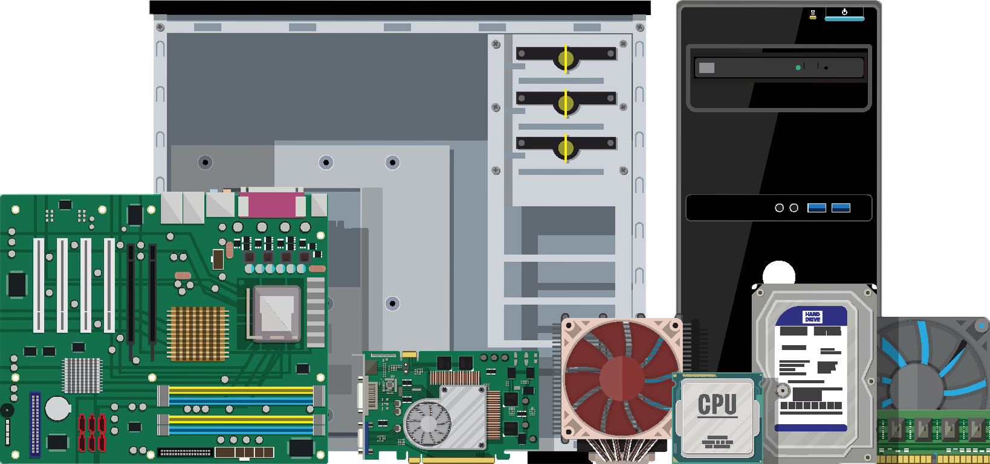
The Central Processing Unit (CPU)
The Central Processing Unit (CPU) acts as the brain of the system, determining how much work a process has to do, and how difficult that work is.
A difficult task, such as encrypting a large file, will use a lot of RAM and/or CPU.
Easier tasks, like executing the ls command, will require only minimal RAM and/or CPU.

Slide 72
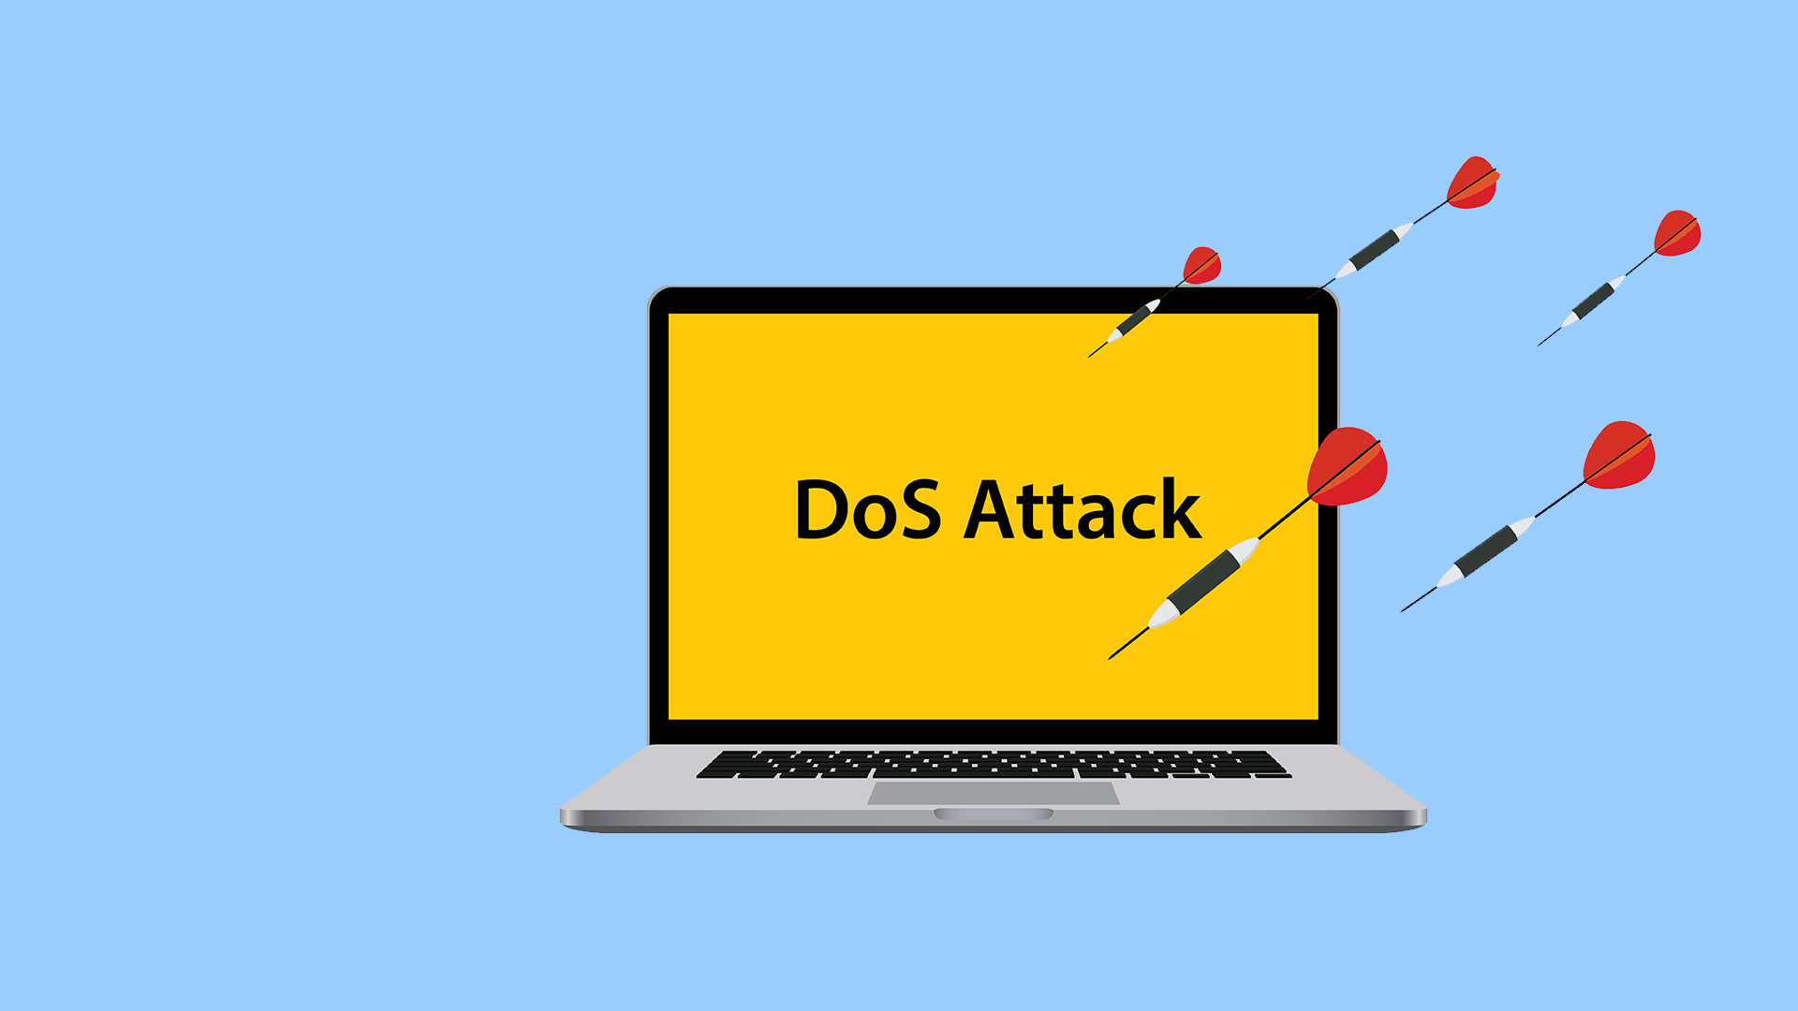
Targeting Resources
Hackers can take advantage of a system’s finite resources.
Hackers can perform denial of service (DoS) attacks by launching processes that eat up memory on a target machine.
This can slow down or crash the machine, making it unavailable to users, thus denying them service.
Notes:
shutterstock_399143986

Slide 73

Targeting Resources
Hackers can also start malicious processes that don't use a lot of memory, and are therefore difficult to spot without specifically looking for them.
One example is a backdoor process. This allows hackers to break into machines undetected.
These don't use much memory because they make a network connection to the hacker's machine, then listen for instructions.

Slide 74
Managing Processes
Linux has several commands for managing processes:
top | Allows you to see all running processes in real time. It updates every three seconds to show what’s happening on the system.
ps | Allows you to take a snapshot of all the running processes on the system. Different arguments allow you to show different subsets of processes and use this output with other commands.
kill | Used to stop processes, usually ones causing problems. kill attempts to allow a process to finish before it shuts it down.

Slide 75
Dynamic analysis is the process of running a potentially malicious script and monitoring its effects.

Slide 76

We can run a potentially malicious script to determine how it affects system health.
Notes:
shutterstock_1204467562

Slide 77
Demo Scenario
In the following demo, we will:
Ensure that no one has added files to protected directories.
Verify that only registered users are allowed to save files on the machine.
Make sure no suspicious programs have be installed on the system.
Verify the server has been saving log files, containing records of suspicious behavior.
Ensure that attackers haven’t saved malicious files in the temporary files directory.

Slide 78
Activity: Monitoring Process
In this activity, you will monitor the system for processes that should not be running.
Your Senior Admin asked that you record snapshots of processes as well as review processes in real time.
If you notice anything amiss, kill the process and add your findings to the report.
15 Minutes

Slide 80
Monitoring Processes
Completing the activity required:
Using top to monitor for suspicious processes.
Using ps to see what processes are running.
Identifying a suspicious process.
Researching signal flags used with the kill command.
Using the appropriate kill signal to stop the process.

Slide 81
Installing Packages

Slide 82


Packages
Administrators often install additional software to properly harden the machine.
Linux offers downloadable tools called packages.
New packages are installed with a tool called package manager.
We’ll use the Ubuntu package manager, called aptitude. We will use aptitude with the command apt.
Notes:
shutterstock_1363031105

Slide 83

Packages
sudo apt install <package name>
Linux searches databases to find information about <package name>. If found, it will be downloaded.
These databases are known as repositories.
Repositories specifically used to store and distribute packages are known as Personal Package Archives, or PPAs.

Slide 84
Packages
Today, we’ll install the following packages.
lynis | Checks that a Linux machine is properly secured.
john | Verifies that users are using strong passwords.
chkrootkit | Scans machines for the presence of a malware called rootkit.
tripwire | Monitors the file system for suspicious changes.

Slide 85
Activity: Installing packages.
In this activity, you will install and configure
tripwire, chkrootkit, john, and lynis.
15 Minutes

Slide 87

Installing Packages Review
This activity required the following:
Using sudo apt to install the three listed packages.
Following additional installation steps for Tripwire.
Using man pages to find a solution.
This activity gets us ready to implement File Integrity Monitoring.

Slide 88
Installing Nano

Slide 89
In the last section of the day, we’ll make changes and add new files using Nano.

Slide 90

After investigating files, stopping malicious processes, and installing tools to help us audit a system, we need a method for keeping lists of our findings and editing system and configuration files.
Notes:
shutterstock_1183509634

Slide 91
Nano
Since many Linux distributions lack a GUI, editing files using the command line is a common task and essential skill for administrator.
Notes:
shutterstock_185734466

Slide 92
Nano
While there are many text editors available, we will be using Nano for the following reasons:
Default Text Editor
Learning Curves
Nano is the default text editor across most Linux distributions.
Other editors, such as emacs and vim, while powerful, have steep learning curves and are more appropriate for seasoned professionals.

Slide 93

Demo Scenario
We will create a message displayed to all users who log into our system.
The senior administrator has asked that we set up a message alerting users that our system will be “down for maintenance.”
This way, we can conduct our audit with out users making further changes.
Notes:
shutterstock_518721298

Slide 94


Demo Scenario
In the following demo, we will need to use Nano to create and edit the /etc/motd file.
motd stands for “message of the day” and will display a message to any user who logs in successfully.
We will also add a message to the motd file that warns users not to use or alter the system while it is down for maintenance.

Slide 95
Nano

Slide 96
Today’s Objectives
By the end of class, you will be able to:
Name three of the most important Linux distributions.
Navigate the Linux file structure using the command line.
Manage processes with the top, ps, and kill commands.
Install packages using apt.
Edit configuration files using nano.

